Slide 1

BOBtheBot : A Mental Health Companion
Guide,
Lakshmi S
Assistant Professor
CSE Department
Group Members,
Ashwin
Megha P S
Vidya Prasannan
Vishnu B Dev

Slide 2
Proposed Method
The proposed machine is a chatbot which takes users’ chat as input and predicts the percentage of various emotions .
Emotion percentages of emotions such as Joy, Shame, Anger, Disgust, Sadness, Guilt, and Fear are calculated.
The chatbot is trained to handle simple conversations and meanwhile passing the users’ chat to emotion detection model which classify the users’ chat into the emotions.
Based on this classification, the percentage of each emotion is calculated by taking the total number of conversations into account.

Slide 3
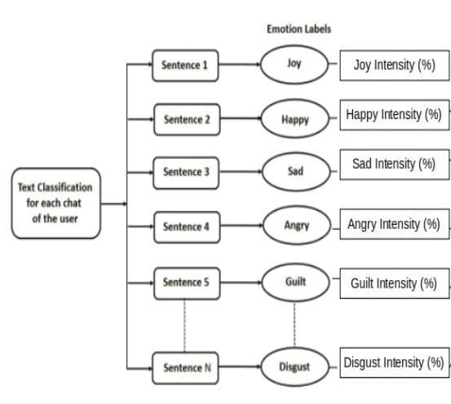
Proposed model

Slide 4
Modules
Dataset Description
Pre-Processing
Training and Testing
Emotion Percentage Calculation

Slide 5
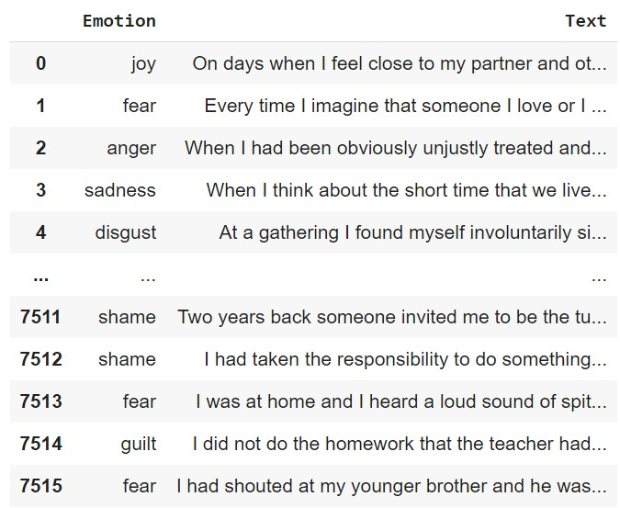
Dataset Description
Emotion Detection Model:
ISEAR Dataset:
International Survey on Emotion Antecedents and Reactions (ISEAR) dataset consists of 7652 phrases and 1542 emotional words.
It is categorized into several categories of emotions such as Joy, Shame, Anger, Disgust, Sadness, Guilt, and Fear

Slide 6
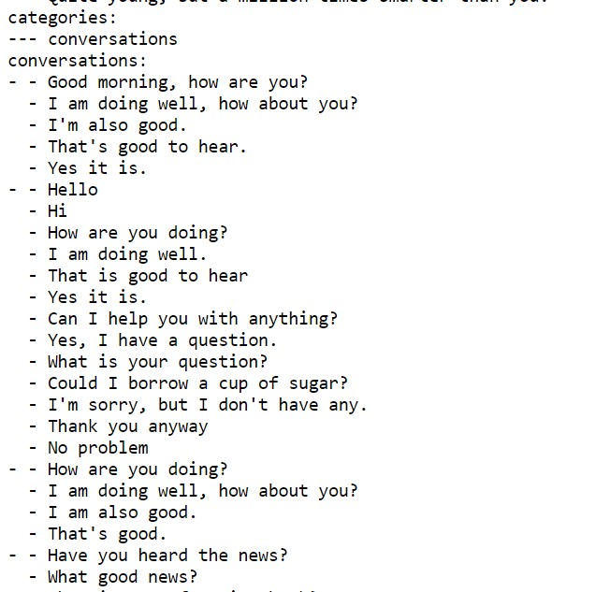
Dataset Description
Chatbot Model:
Collection of YAML files:
YAML ("YAML Ain't Markup Language") is a human-readable data-serialization language commonly used for configuration files and in applications where data is being stored or transmitted.
Each of YAML files handling various contexts in the conversation is combined together to use here.

Slide 7
Pre-Processing
ISEAR (For Emotion detection model)
Data cleansing:
This process involves removing unwanted characters, converting entire text into lowercase, spelling correction, rare word removal and the removal of stopwords using NLTK.
Label Encoding:
The emotion label corresponding to each sentence of the dataset is encoded into integer values.

Slide 8
Contd.
Splitting the dataset:
The dataset is split into two for training and testing in a 9:1 ratio.
Lemmatization:
This process groups together the inflected forms of a word so they can be analysed as a single item. Word.lemmatize() function in the TextBlob package is used.
Forming Word Vector:
Scikit-learn 's CountVectorizer is used for obtaining vector representation for words.

Slide 9
Contd.
YAML Chat Dataset(For Chatbot Model)
Classification:
Data is classified into lists of possible inputs and responses.
Label Encoding:
The intent corresponding to each conversation text is encoded into integer value.
Tokenization:
Text sentences are converted into tokens.

Slide 10
Training and Testing
Emotion Detection Model
LSVM (Lagrangian Support Vector Machine) model is used for training.
It works by mapping data to a high-dimensional feature space so that data points can be categorized, even when the data are not otherwise linearly separable.
A separator between the categories is found, then the data are transformed in such a way that the separator could be drawn as a hyperplane.
Following this, characteristics of new data can be used to predict the group to which a new record should belong.

Slide 11
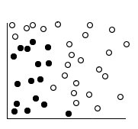
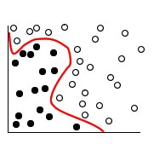
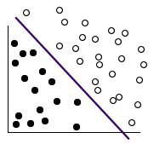
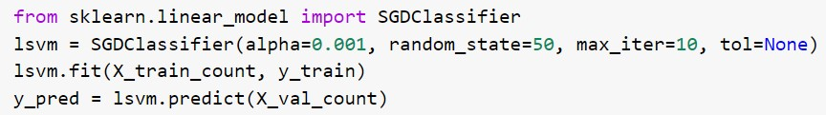
Original Data Data with separator added Transformed data
Emotion detection model is trained by taking text at X-axis and label at Y-axis.
On testing, the model achieved 56% accuracy.
A text input given to this model gives the emotion of the sentence as output.

Slide 12
Contd.
Chatbot model
LSTM (Long short-term memory) model is used for training.
It is a deep learning model which have feedback connections and can process entire sequences of data.
A common LSTM unit is composed of a cell, an input gate, an output gate and a forget gate.
The cell remembers values over arbitrary time intervals and the three gates regulate the flow of information into and out of the cell.
The Chatbot model trains the chat sentences against the labels.

Slide 13
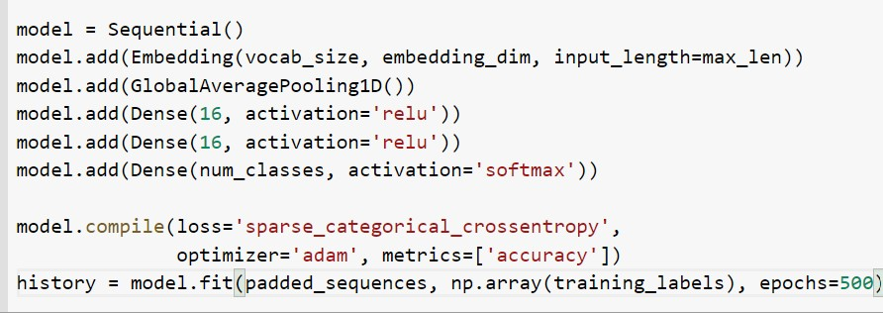
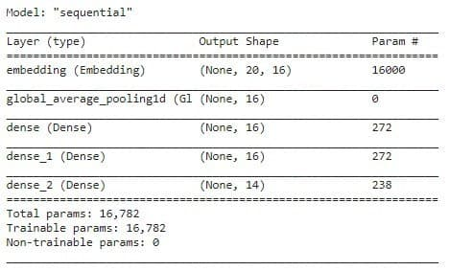
Contd.
The model achieved 99% accuracy.
When a text is given as input to the model, it locates a set of responses corresponding to the intend of input text.
The response with highest cosine similarity is printed as output(reply).

Slide 14
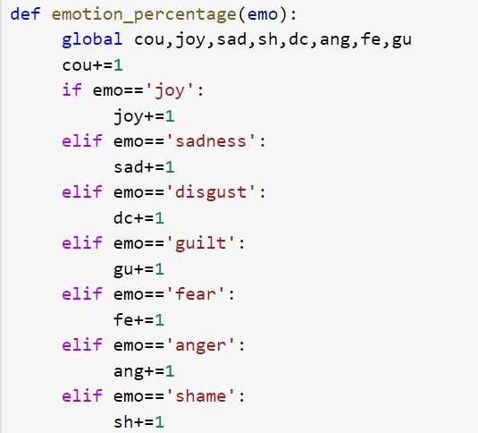
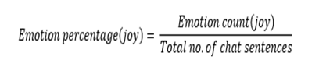
Emotion Percentage Calculation
The two models (Emotion Detection Model & Chatbot Model) are pipelined together in such a way that the users’ chat input is also fed into the emotion detection model.
The result (emotion) of each sentence is stored till the chat ends.
The count of each emotion is used to calculate the percentage of each emotions in the entire chat.

Slide 15
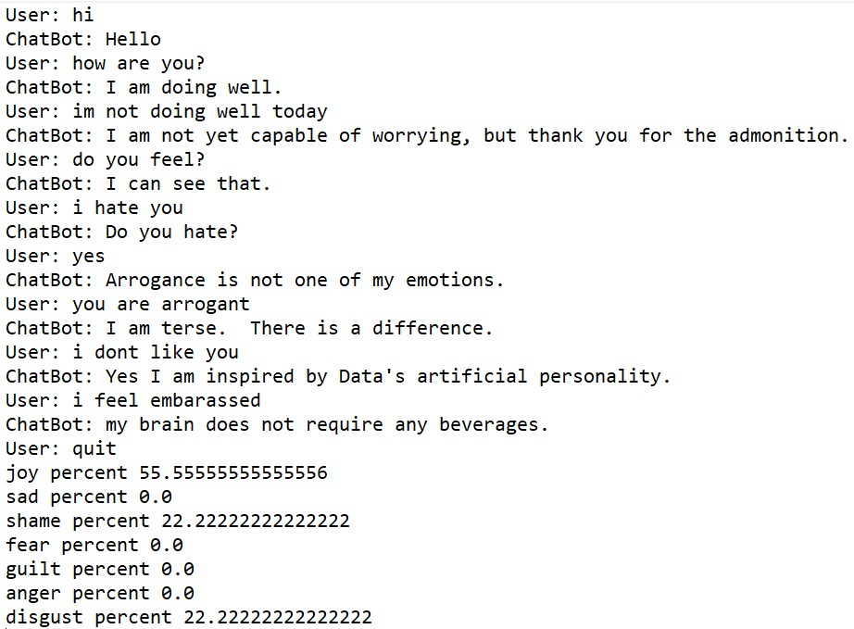
Interface
The program works on simple command line interface.
On giving the command ‘quit’ , the execution stops by printing the emotion percentages.

Slide 16

Thank You

